Slide 1
Reliance Industries & The Walt Disney Company's India Media Merger
Redefining India's Media Landscape
Preethi.S

Slide 2
Scenario Overview
Reliance Industries and Disney merge media operations in India.
Strategic joint venture valued at $8.8 billion.
Reliance controls 60%, Disney holds 36.84%.
Reliance invests $1.4 billion for growth.

Slide 3

Background

Slide 4
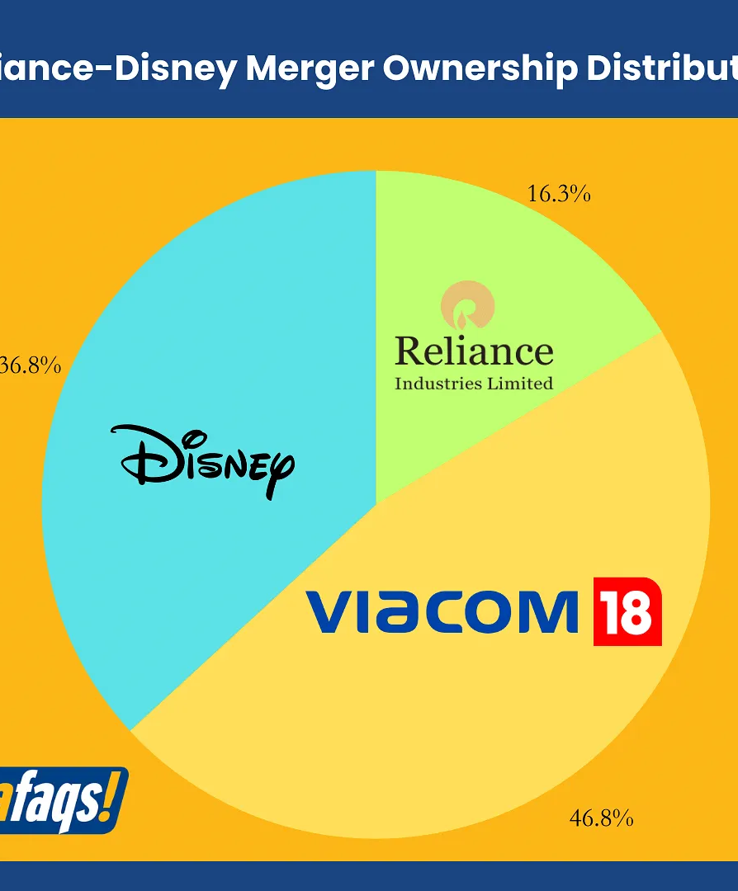
Background
Reliance Industries: Diversified conglomerate with Jio platforms.
Viacom18: Entertainment and sports player.
Disney: Global entertainment powerhouse.
Disney+ Hotstar impacted by IPL rights loss.

Slide 6
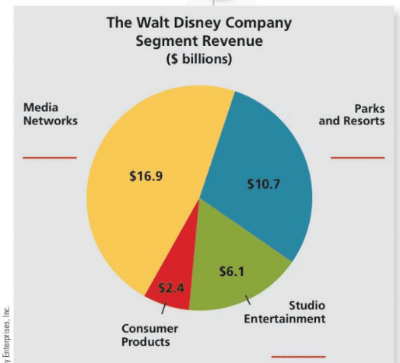
Strategic Fit
Reliance
Disney
Reliance: Expands digital ecosystem, content leadership, and market dominance.
Disney: Mitigates risk, optimizes capital, and gains local expertise.
Long-term vision: Creates media powerhouse, adapts to market changes, and expands globally

Slide 7




Deal Structure Analysis:
Joint venture shares risk, expertise, and regulatory ease
Ownership Structure:
The newly formed joint venture, valued at Rs 70,352 crore (approximately $8.5 billion), is majority-owned by Reliance, with a 63.16% stake.
Reliance owns 60%, Disney owns 36.84%
Advantages and disadvantages for both Reliance and Disney

Slide 8
Financial Terms & Implied Valuation
Transaction value: $8.5 billion.
Reliance invests $1.4 billion.
Pro forma revenue for FY24: $3.1 billion.

Slide 9
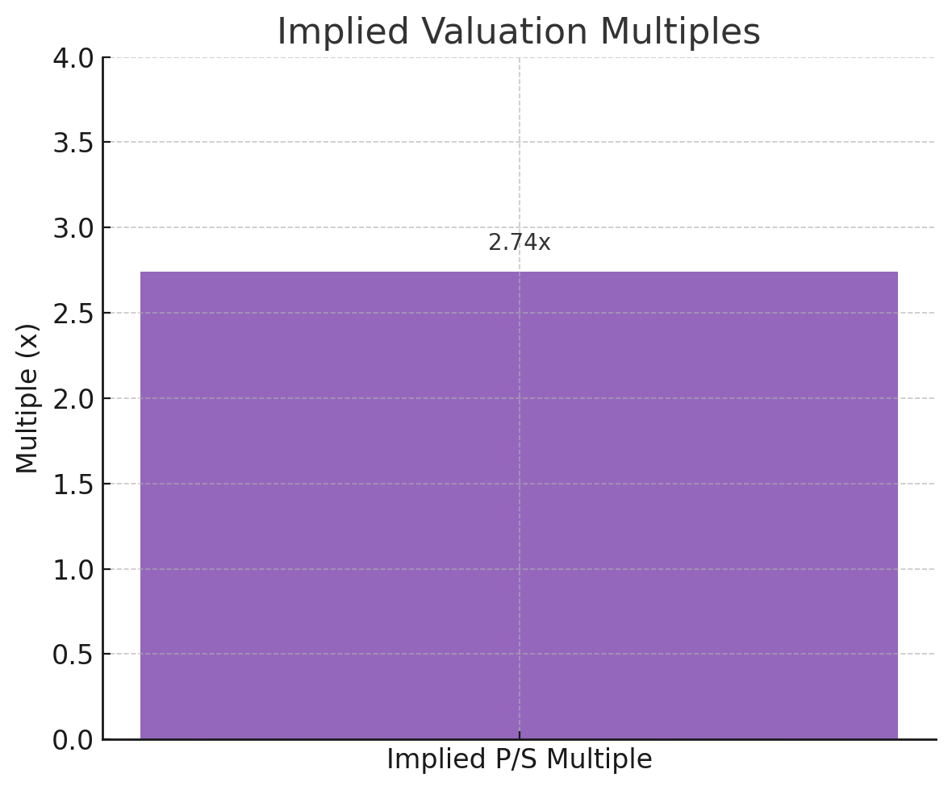
Implied Valuation Multiples
Implied P/S multiple: 2.74x
Challenges in valuation: market changes, limited disclosure, uncertainty in cash flows.
Impact of IPL rights loss on Disney+ Hotstar.

Slide 10
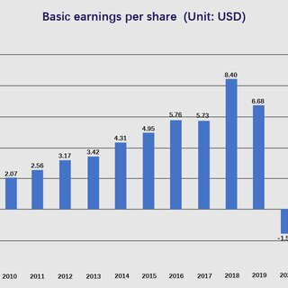
Financing Structure and Cash Flow Implications
Reliance's $1.4 billion infusion: growth investments, operational efficiency.
Impact on cash flow and balance sheet: Reliance and Disney

Slide 11
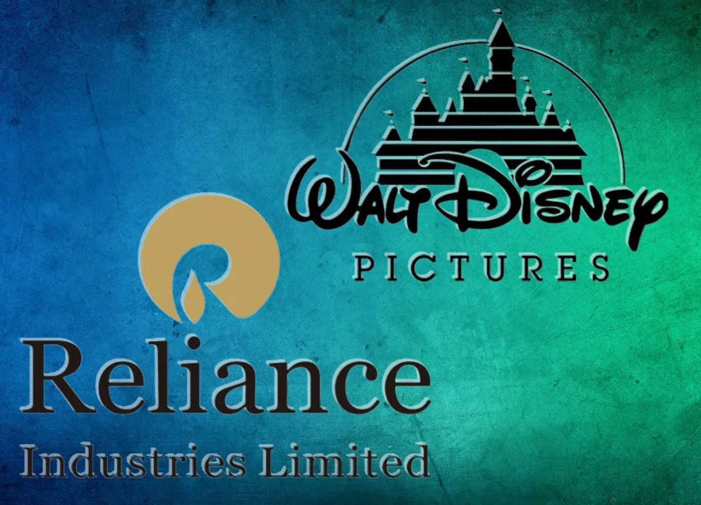
Conclusion:
Significant consolidation in India's media sector.
Combining strengths to create a dominant player.
Strategic rationale, deal structure, valuation implications, and financial considerations.

Slide 12


